Slide 1
Volumetric Error Compensation
Team Lead: Joseph A. Steurer UI & Workflow: Charles Ortman
Measurement Alignment: Alex Bertels
Command Alignment: Kevin Zheng

Slide 2
Project Motivation
maintenance personnel calibrate machine tools on the production floor
need to generate compensation tables for specific machine configurations

Slide 3
VEC Application Overview
a five axis machine tool collects measurements, positions are measured 200-500 times during operation
measurements are aligned to ensure a constant offset exists between readings
MATLAB script runs least-squares algorithm on aligned measurements, which fits a transformation between measurement and machine coordinates
command positions must be aligned with measurements; the predicated value at some command position should be close to a measurement
full model of kinematics is fit using an implicit loop method
Compensation tables generated using a genetic algorithm

Slide 4
Project Focus
ILM/GA functionality is black boxed in a DLL because its Boeing IP
our job is to automate preprocessing and facilitate evolution of data throughout application workflow
project is a linear task, transforms raw data into meaningful information

Slide 5
Roles and Responsibilities
Each team member is responsible for a specific set of tasks
Charles: GUI, Input Parsing
Alex: measurement alignment
Kevin: command alignment
Joseph: ILM/GA performance reports, table formatting
five weeks to do it, each team member will talk more about their work

Slide 6
Current Progress
Submitted Requirements Document and Project Plan to Dr. Morales and Boeing
Project Plan lists each requirement sequentially, lists the steps required to complete each requirement, estimates the amount of effort in hours, sets a date the requirement is to be started and completed by
Had our first commit to bitbucket!

Slide 7
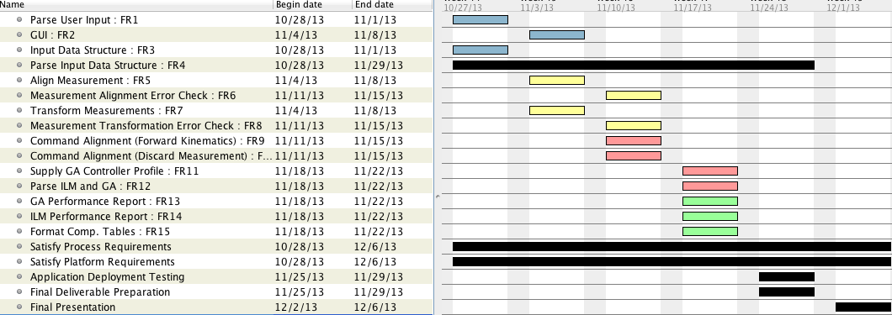
Project Timeline

Slide 8
Input Data Structure
InputDataStructure
+ rawLongShortTool: Dictionary<integer, List<double> > + maLongShortTool: Dictionary<integer, List<double> > + caLongShortTool: Dictionary<integer, List<double> > + machineConfiguration: integer + controllerProfile: integer + toolLength: double + toolOffset: double + commandPositionData: MATLAB DLL

Slide 9
GUI (Charles)
Create Input class to parse, contain, and output information from:
Tool CSV measurement data
User-driven input fields
Create GUI class from the WinForms .Net API
Familiar user-friendly Windows interface with a Boeing-tailored theme
Methods here will interact with the Input class to validate and store the user-driven input

Slide 10
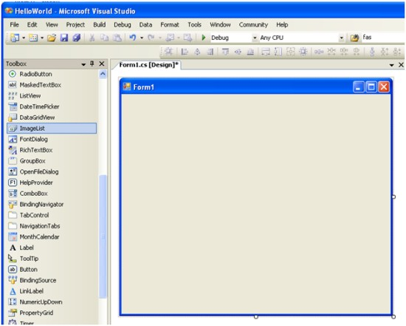
GUI (Charles)

Slide 11
GUI (Charles)
Program Progress GUI
GUI class will be updated to receive “progress updates” from the other classes in the application
Progress updates will be normalized to a 0-100 % completion bar on the main GUI
Finalize aesthetics of GUI elements
Verify interface usability
Unify all elements with a single appealing and professional theme

Slide 12
GUI (Charles)
VECGUI :: Form
+ ids: InputDataStructure + WinFormObjects: Form
VECGUI(): void + getIDS() : InputDataStructure + setIDS(): InputDataStructure

Slide 13
Measurement Alignment (Alex)

Slide 14
Measurement Alignment (Alex)
Machines produce long and short measurements
Format: < X, Y, Z > coordinates
Problems: misalignment or skipped values
Corrected values must be transformed
Must use provided MATLAB script

Slide 15
Measurement Alignment (Alex)

Slide 16
Measurement Alignment (Alex)
Align Measurements
Problem Conditions: Maximum value or 2-3 standard deviations
Solutions
Attempt to remove elements to fix the problem
Use a brute force alignment technique to fix the problem
Measurement Alignment Error Check
Request more/new data if fix cannot be found

Slide 17
Measurement Alignment (Alex)
Transform Measurements
Convert the MATLAB transformation script into a DLL
Using a C# program, pass input to, execute, and read output from the MATLAB DLL automatically
Measurement Transformation Error Check
Request more/new data if transformation is invalid

Slide 18
Measurement Alignment (Alex)
MeasurementHandler
m_ids: InputDataStructure transformationScript: MATLABDLL
+ MeasurementHandler:():InputDataStructure + alignMeasurements(): void - alignmentErrorCheck(): boolean + transformMeasurements(): void - transformErrorCheck(): boolean

Slide 19
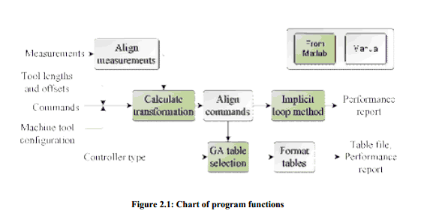
Command Alignment (Kevin)

Slide 20
Command Alignment (Kevin)
Align Commands
Use provided kinematic equations to predict the measured position of machine for a given command
Errors between commanded positions and measurement positions are several order of magnitude in difference.
i.e. 5-axis machine tool are on the order of 10⁻² in, but errors are in 10¹ to 10² in

Slide 21
Command Alignment (Kevin)
MatLab DLLs
Convert MatLab files in dll
Implicit Loop Method
GA Table Selection
Parse Controller Profile

Slide 22
Command Alignment (Kevin)
Implicit Loop Method
A method of analysis for calibrating mechanisms having closed kinematic chains.
Determines parameters and their accuracy.
Based on MLE principle for estimating parameters of a given statistical model
C. Hollerbach, J. Wampler and T. Arai, "An Implicit Loop Method for Kinematic Calibration and Its Application to Closed-Chain Mechanisms," IEEE Trans. Robotics and Automation, vol. 11, no. 5, pp. 710- 724, 1995.

Slide 23
Command Alignment (Kevin)
GA Table Selection
Requires Controller profile and aligned commands
Selects the appropriate tables after running for around 20-30 hours

Slide 24
Command Alignment (Kevin)
CommandMeasurement
longMeasurements: XYZCoordinate[] shortMeasurements: XYZCoordinate[] GAScript: MATLABDLL ILMScript: MATLABDLL
+ CommandMeasurement(XYZCoordinate long, XYZCoordinate short[]) + alignCommands(): XYZCoordinate[][] - commandErrorCheck(): boolean

Slide 25
Report and Table Generation (Joseph)
Using output from ILM and GA DLLs, build performance report automatically
Use .net libraries to generate an MS word document for the performance reports, must also auto generate plots
GA outputs compensation tables, need to format for a specific machine type and output to a CSV file

Slide 26
Report and Table Generation (Joseph)
ILM Performance Report:
Date, Machine Type, Machine Name, Machine Controller, Long Tool and Short Tool offset, number of measurements, Link Lengths
Flow machine axis limits (Table)
Model Performance (Table)
Comparison of Table Functions (Plots)
Residuals for Error Models (Plots)

Slide 27
Report and Table Generation (Joseph)
ReportGenerator
-ids: InputDataStructure
+GenerateGAReport(): void +GenerateILMReport(): void +FormatCompTables(): void

Slide 28
Report and Table Generation (Joseph)
GA Performance:
Genetic Algorithm Profile
Genetic Algorithm Best Straightness Tables
Run Time
Comparison of Table Functions (Plots)
Compensation Tables:
Formatted for a user specified controller, text file supplied as an input

Slide 29
Future Work
setting up framework for a long term project; will hand off our work to a team that will continue development
Boeing is monitoring our progress, specifically requesting the deliverables Dr. Morales wants
Next steps: design, coding, testing, deployment
Questions?

